Slide 1

Measuring Customer Satisfaction with Power BI
Fatemeh Vahidnezhad

Slide 2
Customer Satisfaction in an Insurance Company
Gathering data by Polling:
The company gathers data by calling customers and ask them about the services provided such as availability to agents, the transparency in policies, the behavior and knowledge of experts, facility and speed for selling an insurance in two steps:
First step: after selling a service at several subjects like car, fire, engineering, liability, health, and so on.
Second step: after paying compensation for an incident.

Slide 3
The First Dashboard: Customer Satisfaction after Selling
KPIs:
Customer Satisfaction Score (CSAT)
Net Promoter Score (NPS): is a customer loyalty and satisfaction measurement
Availability to Agents
Customer Effort Score(CES): how easy it is for a customer to do business with us

Slide 4
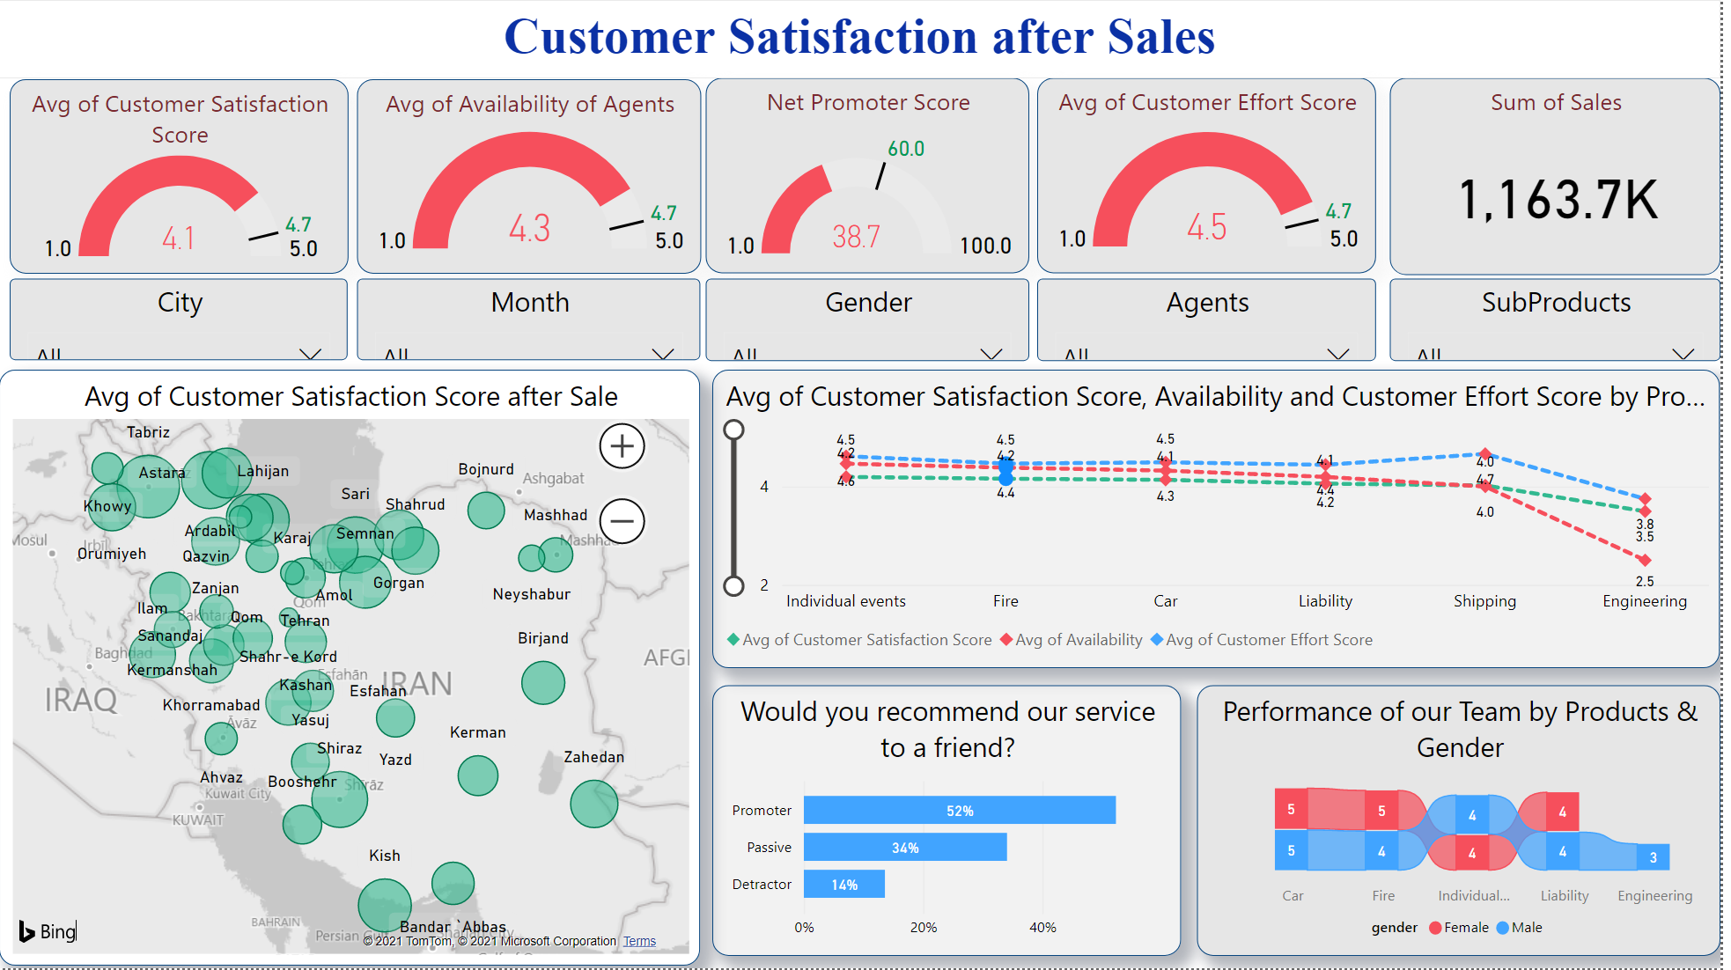
First Dashboard: Customer Satisfaction after Selling

Slide 5
The Second Dashboard: Customer Satisfaction after Paying Compensation for an incident
KPIs:
Customer Satisfaction score (CSAT)
Net Promoter Score(NPS)
Availability to Agents
Waiting Time for paying compensation
Extending a Service

Slide 6
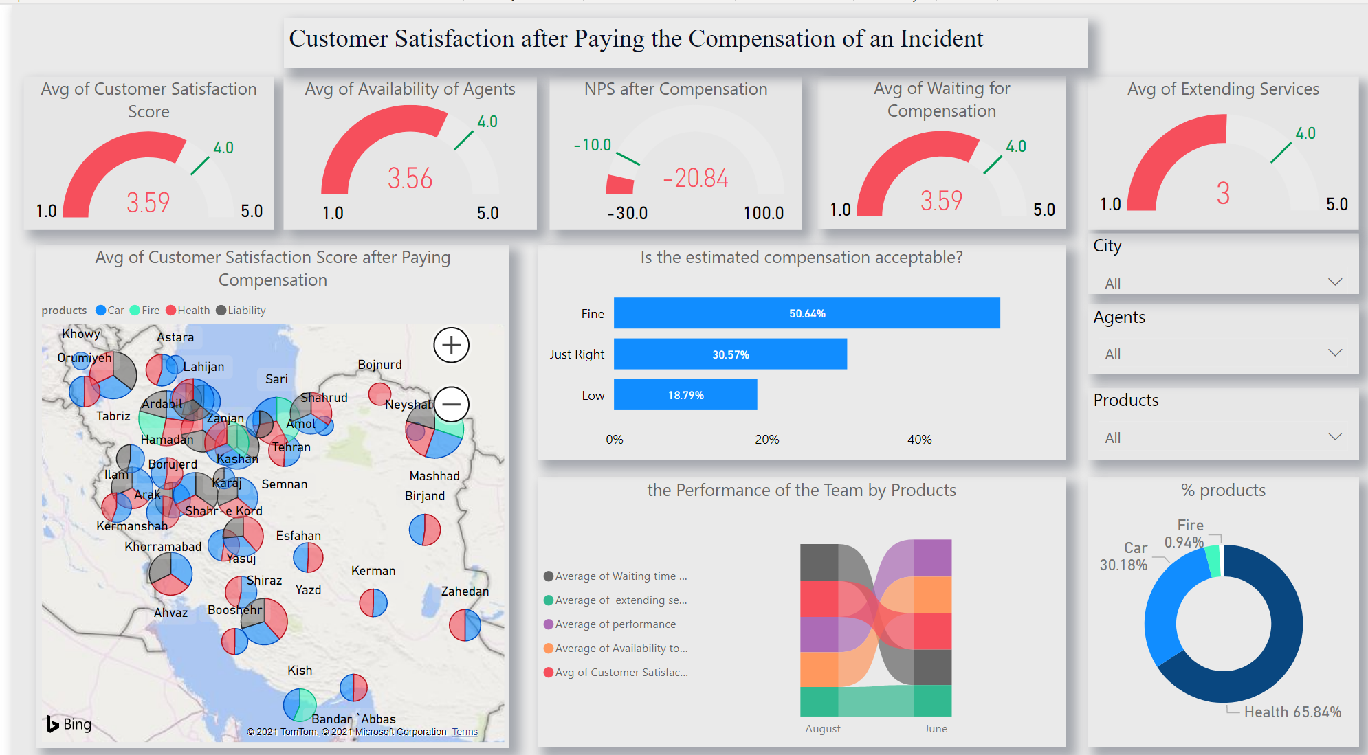
Second Dashboard: Customer Satisfaction after Paying Compensation for an incident

Slide 7
Results & Suggestions
First Dashboard
According to the defined goals, KPI indicators are not far from them.
Second Dashboard
NPS is negative and needs to improve.
Among KPIs, request for extending services is less than other indicators and they should survey reasons.
The number of requests for compensation in health costs is much more than others. Therefore, they can improve KPIs by more focus on health costs than others.
Performance of team in engineering is less than other products, and if they work on this part, they will touch the targets of KPIs.

